Slide 1

Solve the Sphero!
?
?
?
?
?
?
Team 4: Kelly Pickreign, Ryan Huffnagle, Tyler Bembenek, Qidi Fang
?
?
?
?

Slide 2
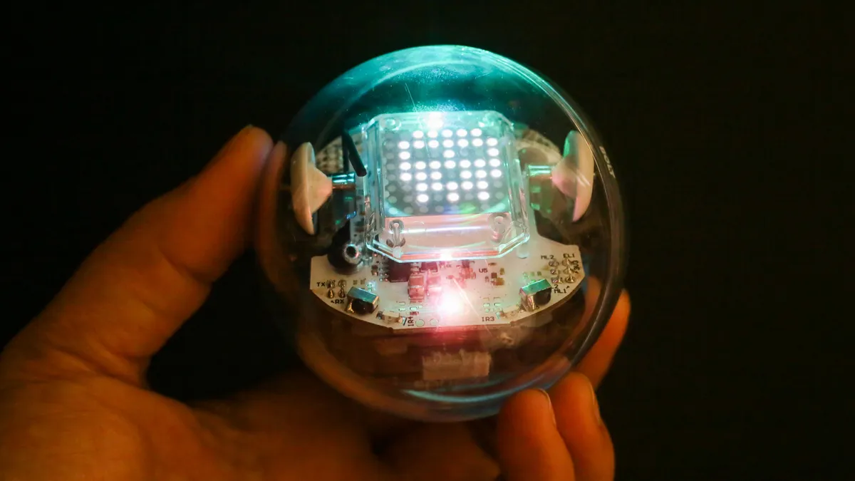
Why Games with Spheros?
Robots will increasingly be part of office workplaces
Fun environment where participants could explore the robot’s capabilities
Games allow for discrete testing scenarios with natural variation
Straightforward division of labor
Focused more on the human-element rather than technical advancement

Slide 3
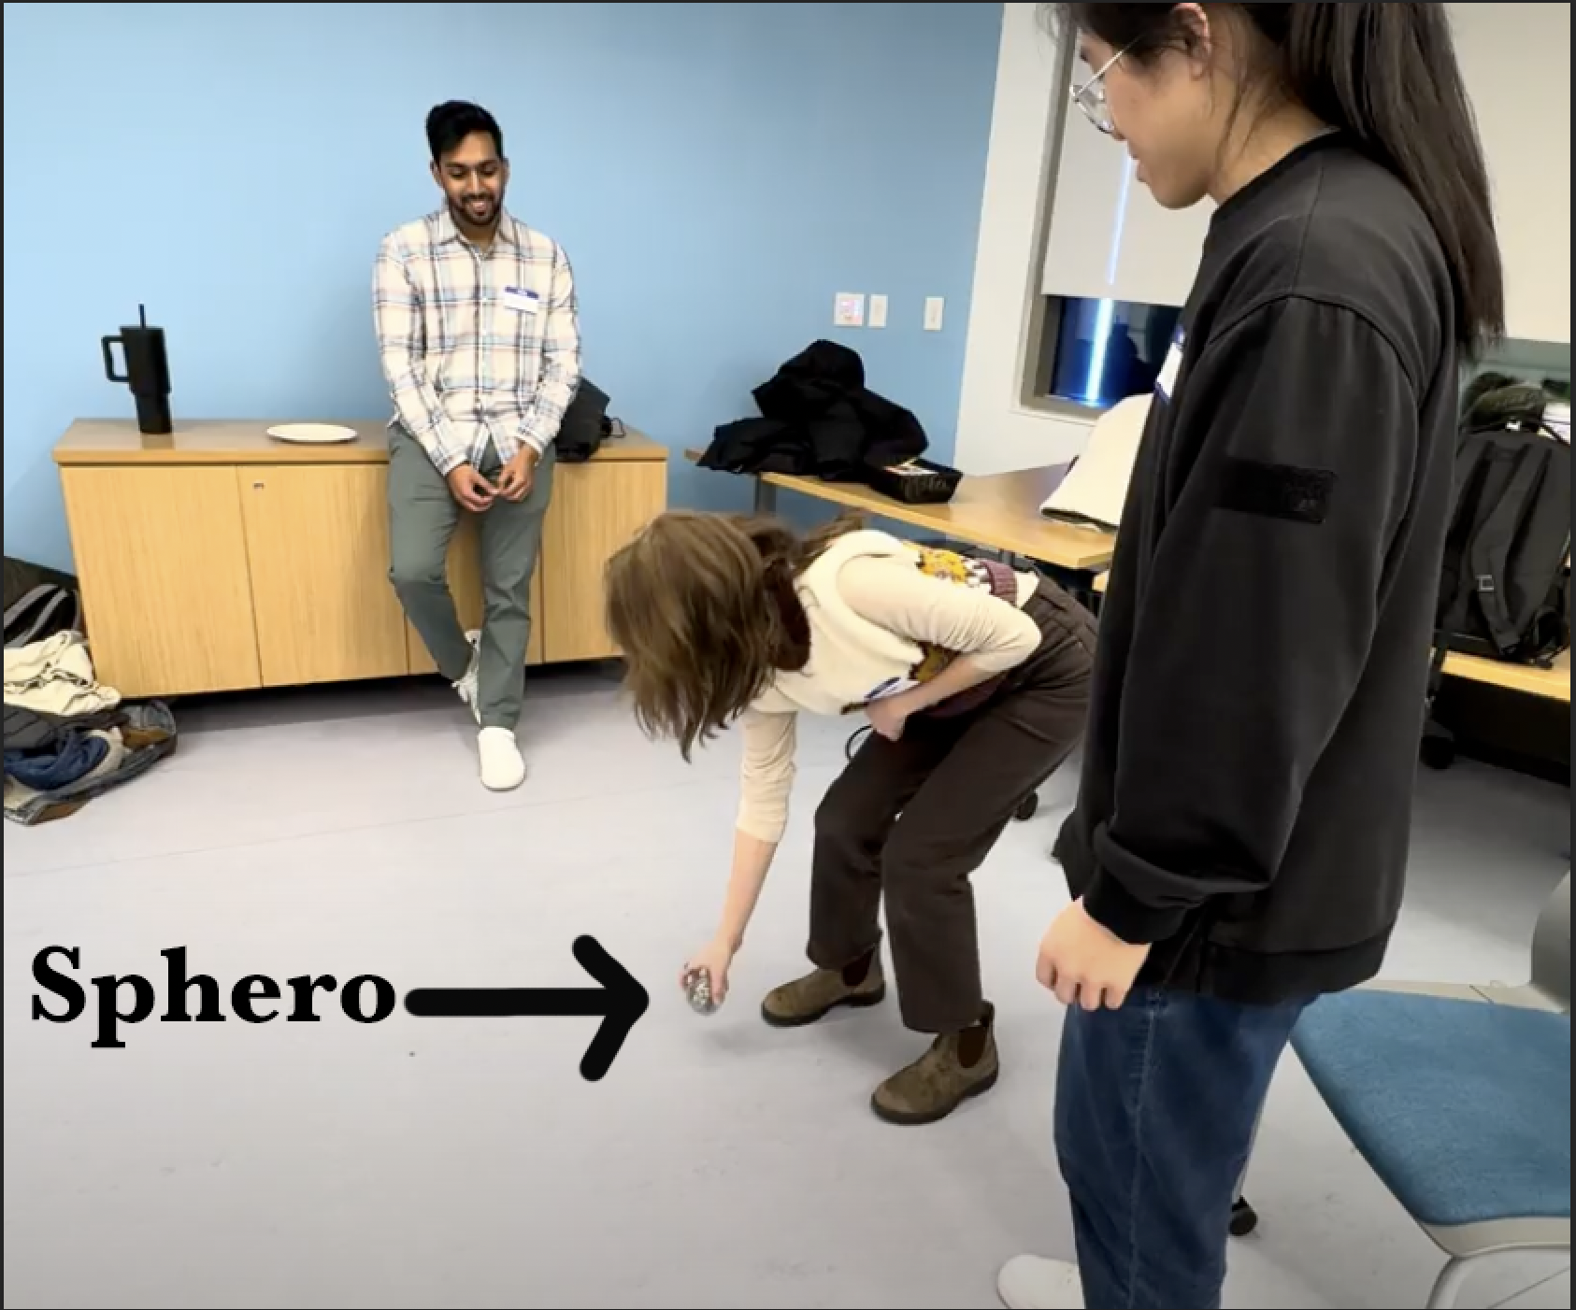
Experiment-(Encouragement vs. Non-Encouragement)
How does encouragement affect team performance, collaboration and sentiment towards robot
User study (participants)
Strangers, groups of three or four
4 games coded into sphero (E/NE)
Measurements: performance, collaboration, and sentiment towards robots
Timing/Completion
Post-study video analysis
Pre and post study surveys
Notes:
Encouragement vs. Non encouragement experiment
Teams of strangers in groups of three or four
4 games coded onto the spheros, each game had an encouragement version and a non
Participants tried to solve the games in their small groups
We measured performance, collaboration, and robot sentiment
timing/completion
Post-study video analysis
Pre and post surveys

Slide 4
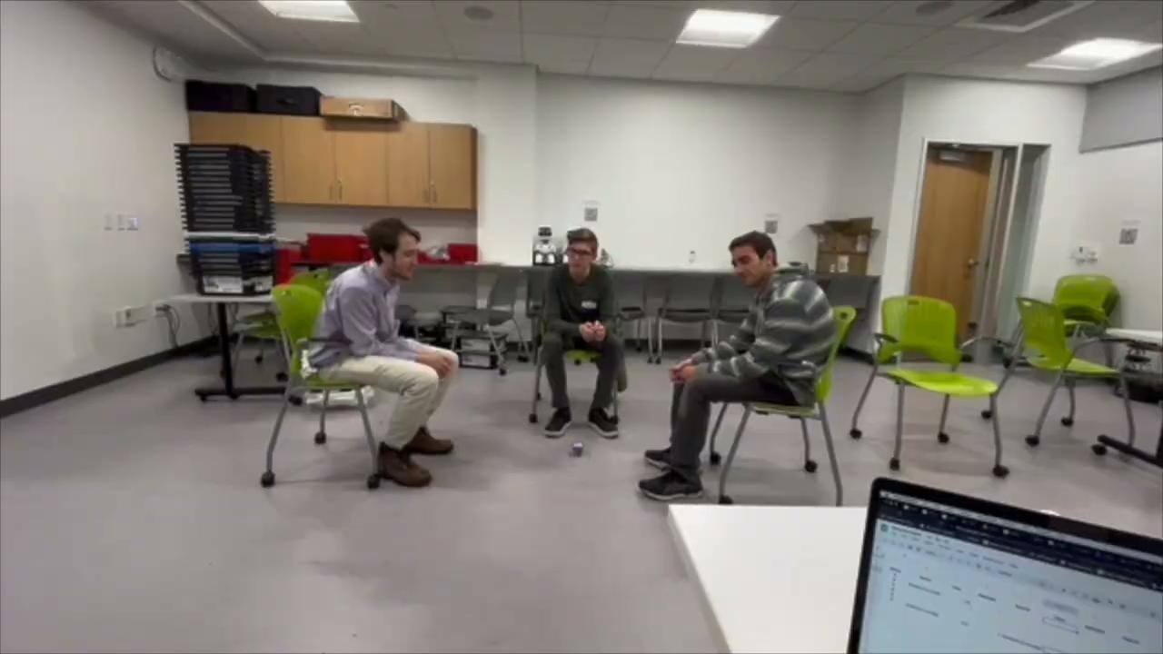
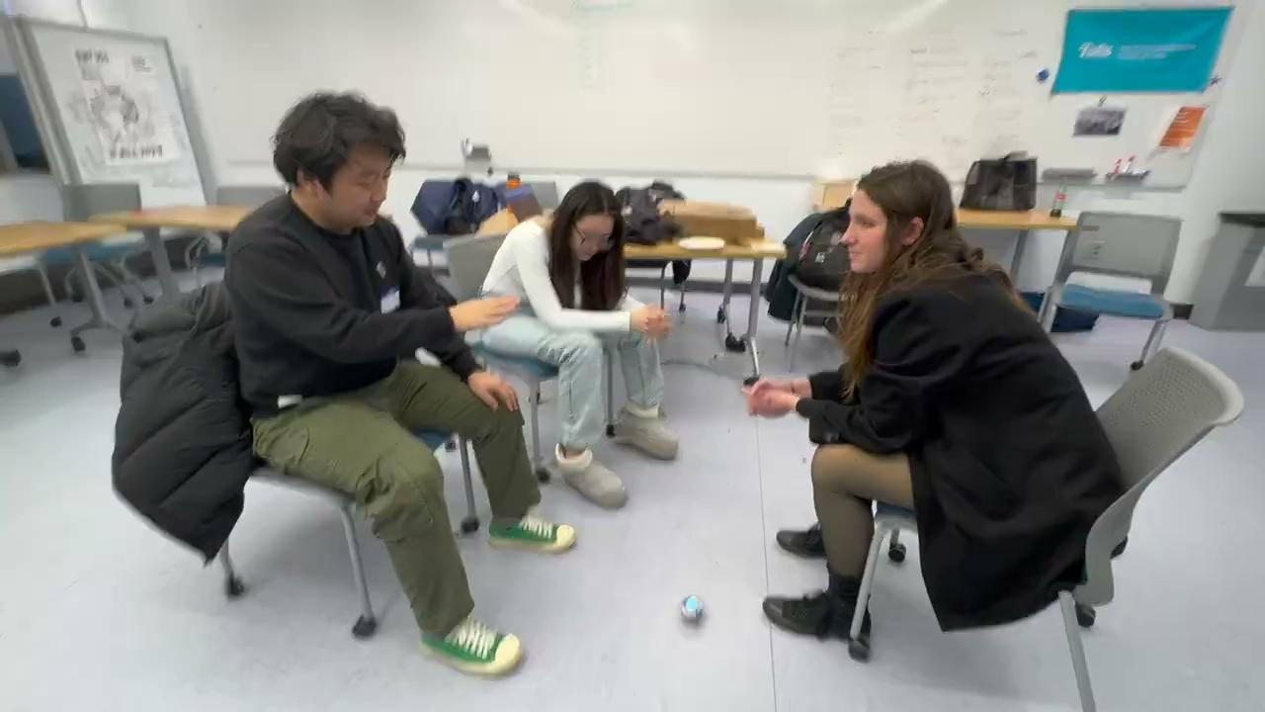
Videos

Slide 5

How well did everything work?
Last minute room reservation but worked out perfectly
Battery problems – but had plenty of backup Spheros/computers
Participants seemed to have a good time, besides some waiting
A few participants didn’t fill out their survey

Slide 6


What We Learned
Encouragement Can Backfire
Negative sentiment increases towards robot when encouragement given on difficult tasks
Participants start to ignore the robot’s instructions

Slide 7

What We Learned
Anthropomorphic Behavior of the Robot Increases Group Cohesion
The encouraging robot game led to increased group interaction and task pass off

Slide 8
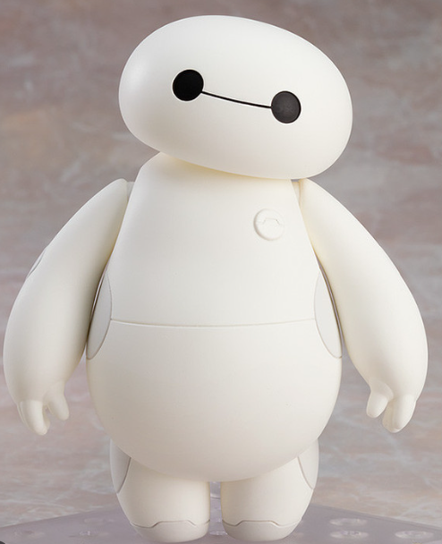
What Could Be Done Better?
Handle every detail of the experiment setup in advance
Standardize the video recording.
More detailed definition of encouragement and condition control
Tips For Future CS133 Students
Try to narrow down the project's intended contribution to a very specific point at first place
Notes:
1.Like in make sure the voice can be recorded very clear and the angle of the video should better be uniformed and the experiments should be recorded entirely which would help do quantitative analysis.
2.such as whether it includes additional hints, whether to unify the gender of the voice, etc. which could lead to more scientific experiments and might have more significant results.
3. Like we transfer from the effect of robots companion to the effect of robots encouragements and final fall into the robots’ encouragement’ effect on team performance and group cohesion.

